Slide 1





[
CareerPath AI
AI‑Powered Career Readiness & Skill Gap Analysis Platform
Presenter: Sharveswar M
Department of Computing Technologies

Slide 2



Problem Statement
Existing platforms provide generic recommendations
No personalized skill gap analysis
Limited integration between learning and job preparation
Students lack data‑driven career insights

Slide 3



Existing Solutions & Limitations
LinkedIn – Generic recommendations
Naukri – Job listings only
LeetCode – Coding practice only
Resume builders – No career intelligence

Slide 4







Proposed Solution
AI
Adaptive
career counselor
career assessments
Analyzer & Trend
Coding
Resume analyzer and Industry trend insights
challenge validation

Slide 5



Technology Stack
Frontend
Backend
Next.js, React, TypeScript, Tailwind CSS
Supabase (PostgreSQL)
AI Services
External APIs
Groq LLM
Piston API, Tavily API

Slide 6
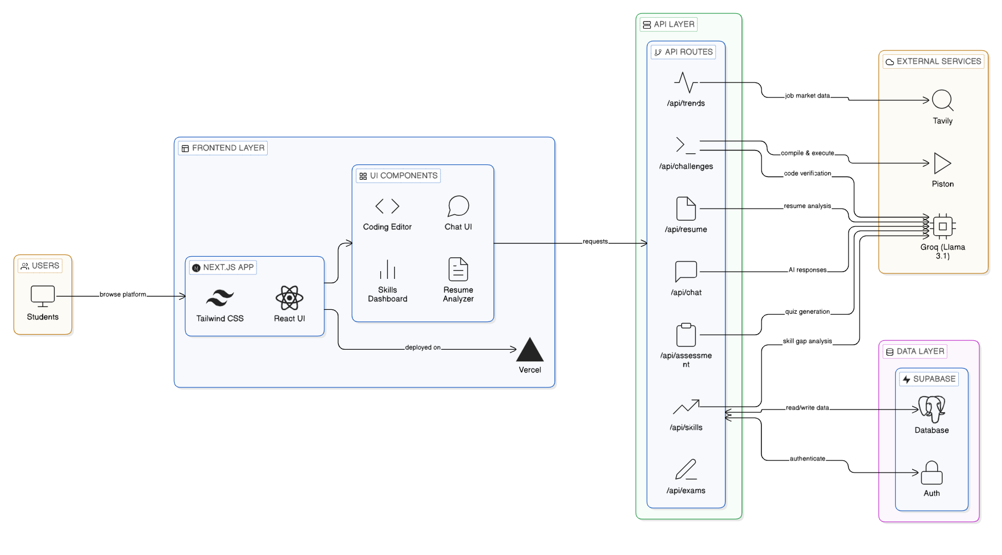

Slide 7
Teacher Portal
Faculty dashboard
Student progress monitoring
Assessment tracking
Data export for reports

Slide 8
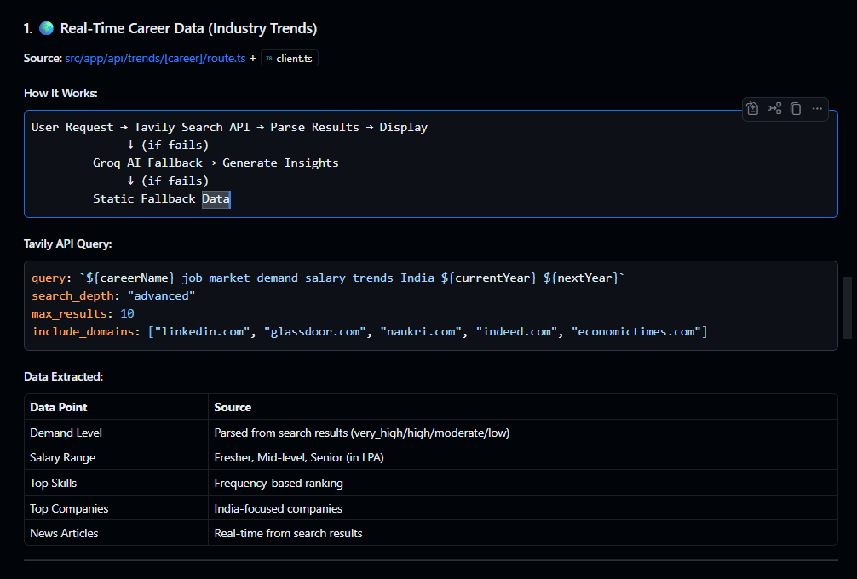

Slide 9

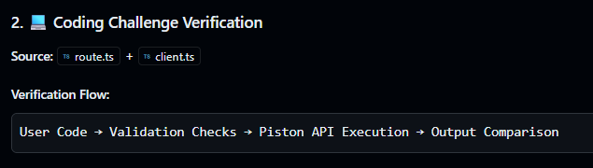
Coding Challenge

Slide 10
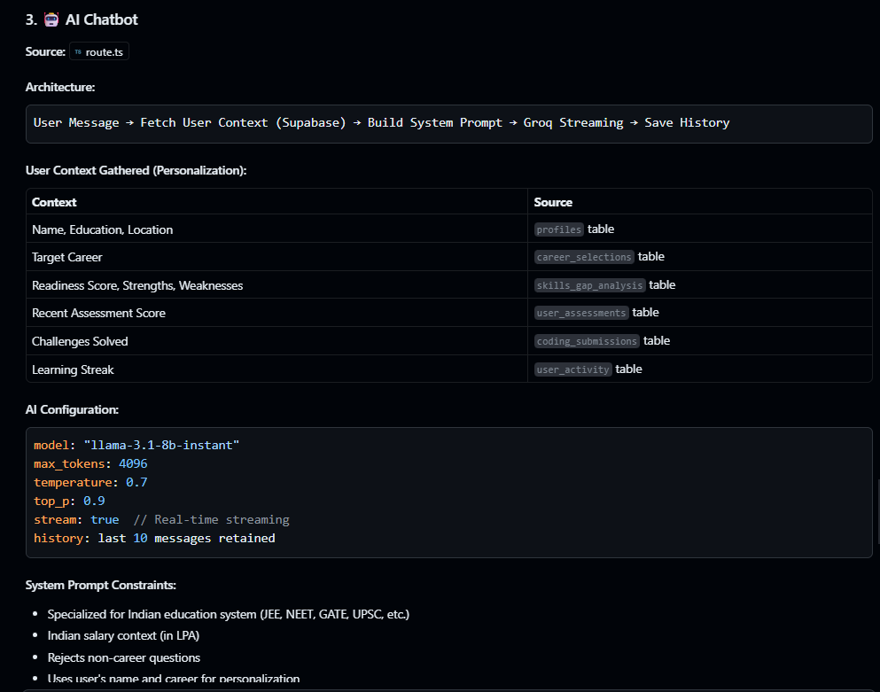

Slide 11
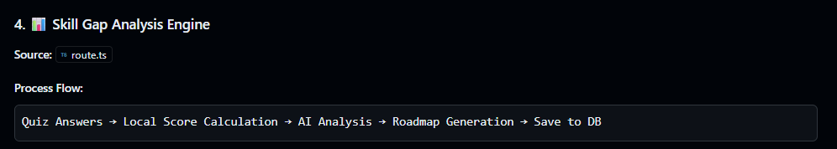
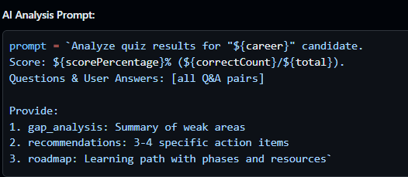

Slide 12

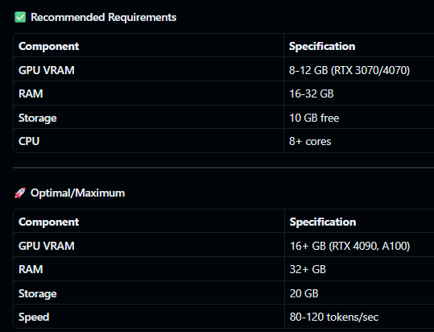
Server Requirements

Slide 13
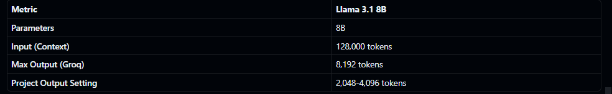
Why we choose this ai model

